Slide 1
Cloud Computing
Ajay J. Singala

Slide 2
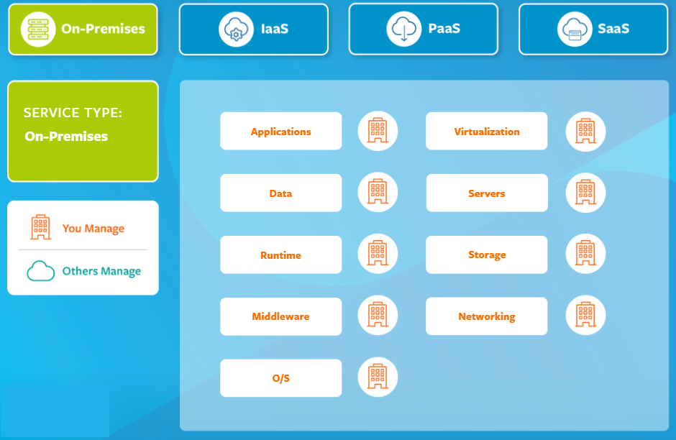

Slide 3
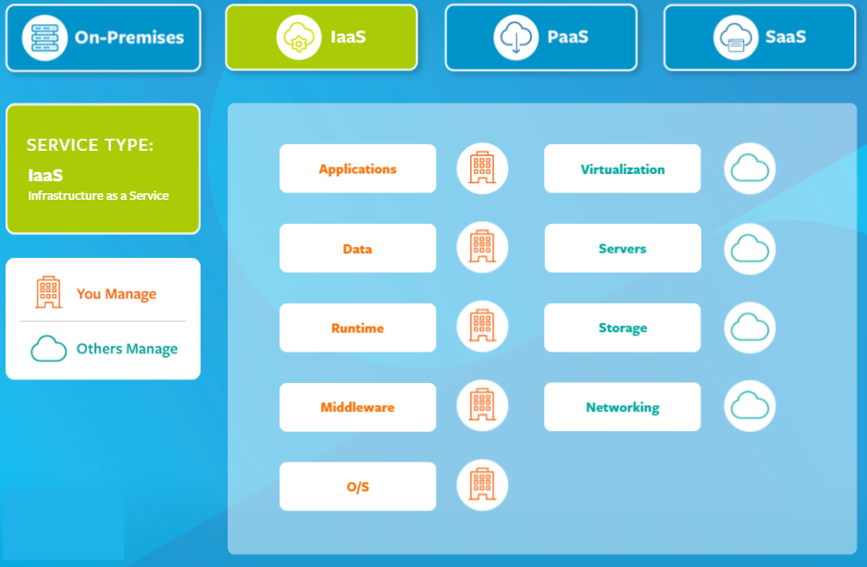

Slide 4
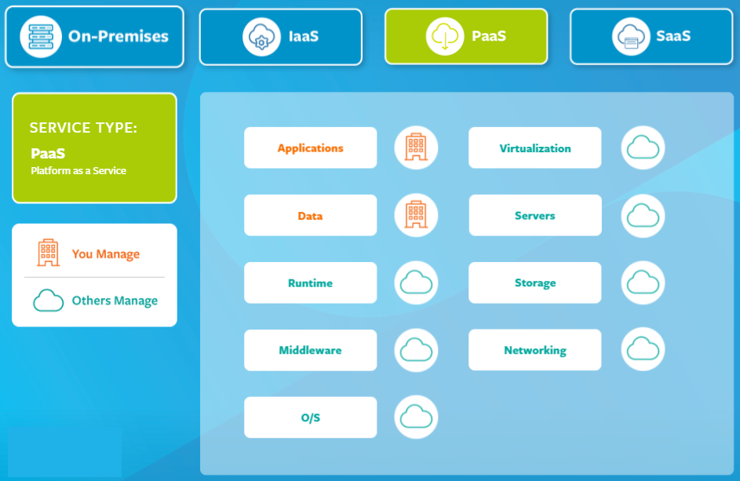

Slide 5
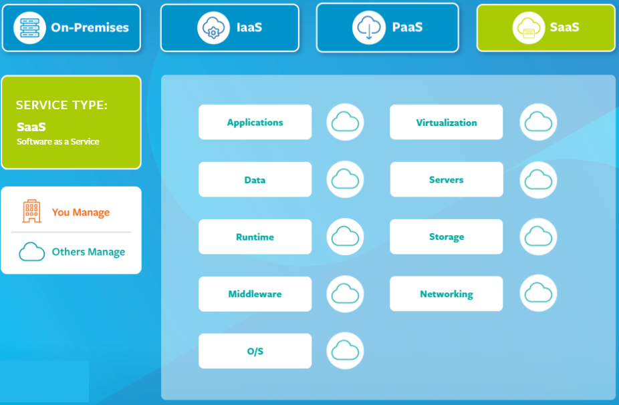

Slide 6
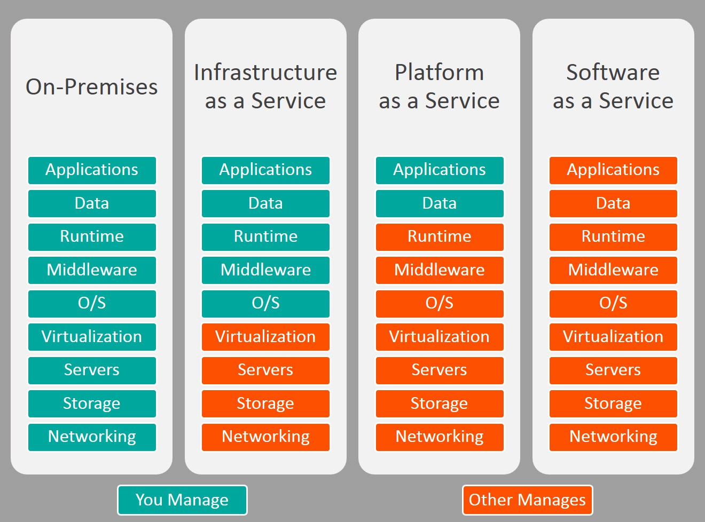

Slide 7
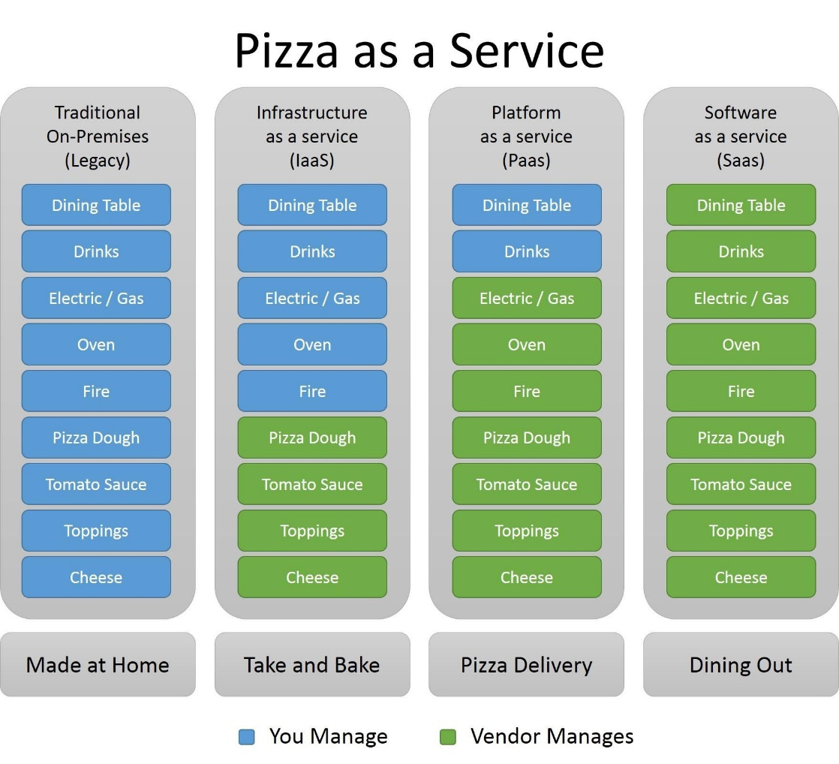

Slide 8
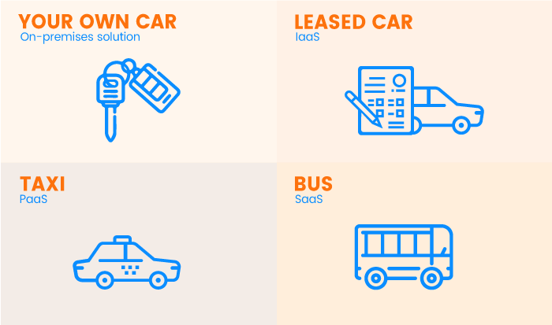
Car-as-a-Service

Slide 9
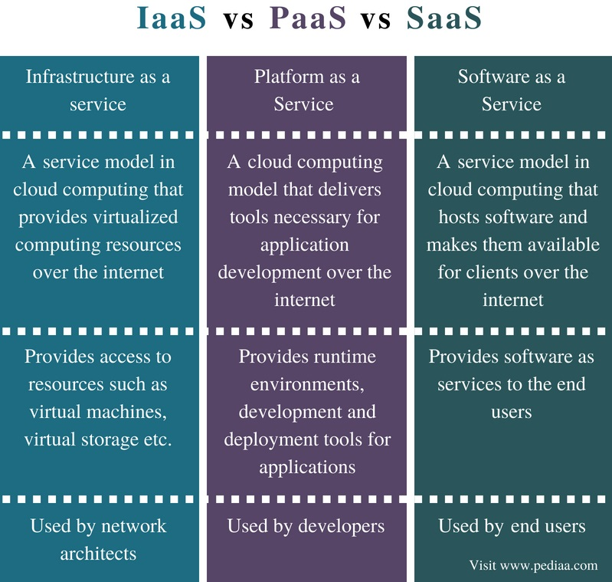
SaaS | PaaS | IaaS
SaaS provides accessible and ready-to-use services for its clients. SaaS provides a solution to almost everything. | PaaS is best for businesses that don’t like to spend on different platforms. It helps users to focus on app development. It also helps in worrying less about infrastructure management. | IaaS is the most flexible of the three services. It is best used for hosting fully built apps. It also provides a general data storage center.

